Slide 1
Discrete outcomes and regression adjustment
Class 4
EDUC 265: Applied Regression Analysis
UCI School of Education

Slide 2
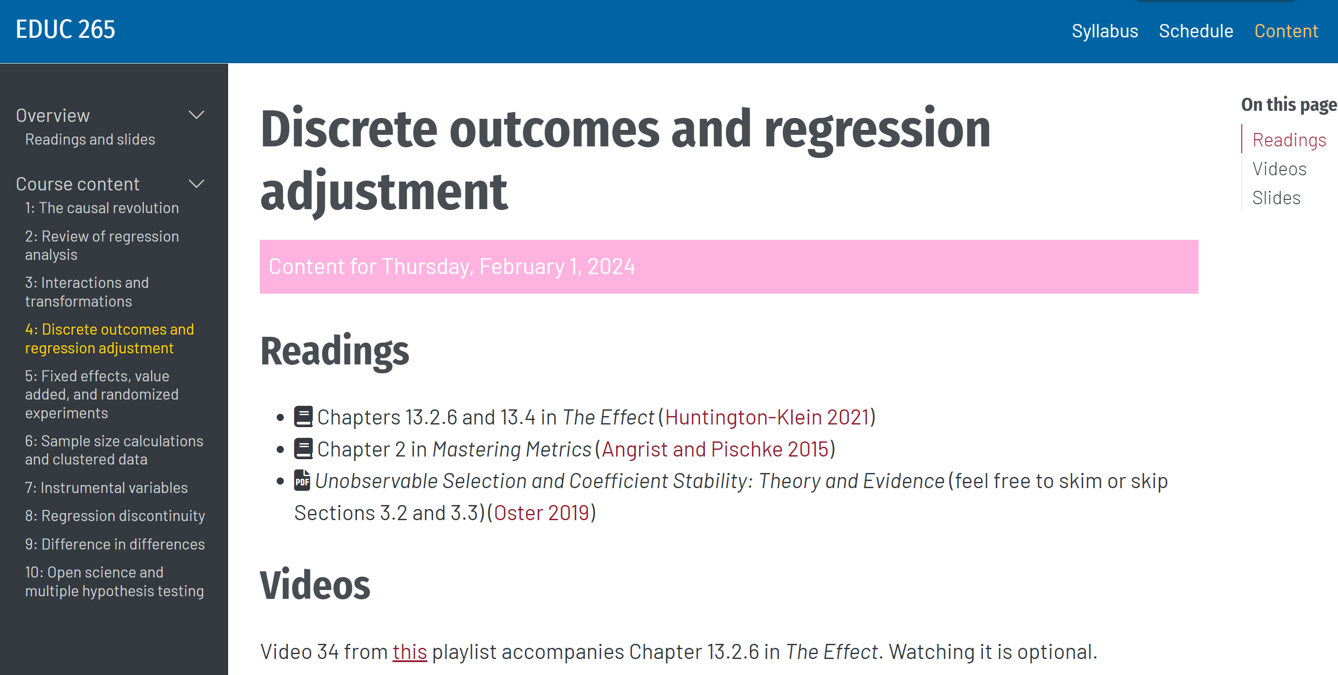

Slide 3
Plan for today
Discrete outcomes
Potential outcomes
Bounding

Slide 4
Discrete outcomes

Slide 5

Many social science outcomes are 1/0s
Graduated college or not
Below the poverty line or above
Dropped out of
high school or not
Proficient or not
Is working or not
Pass or fail
Retained or not
Should’ve said no or yes

Slide 6
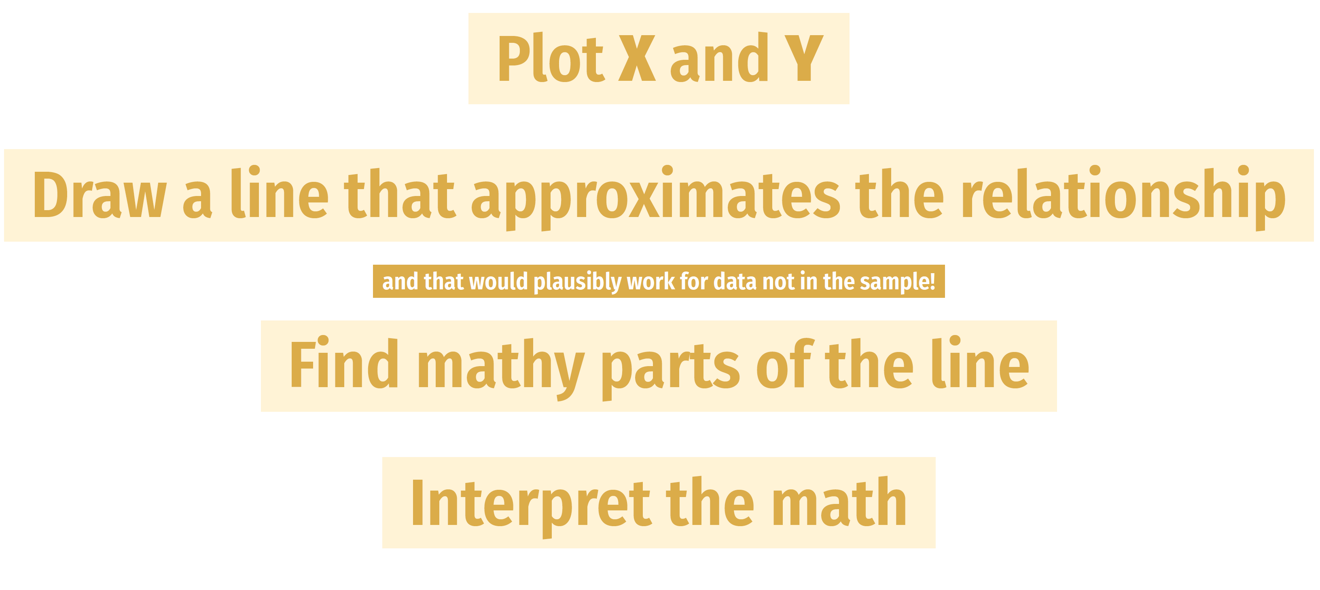
Remember?

Slide 7
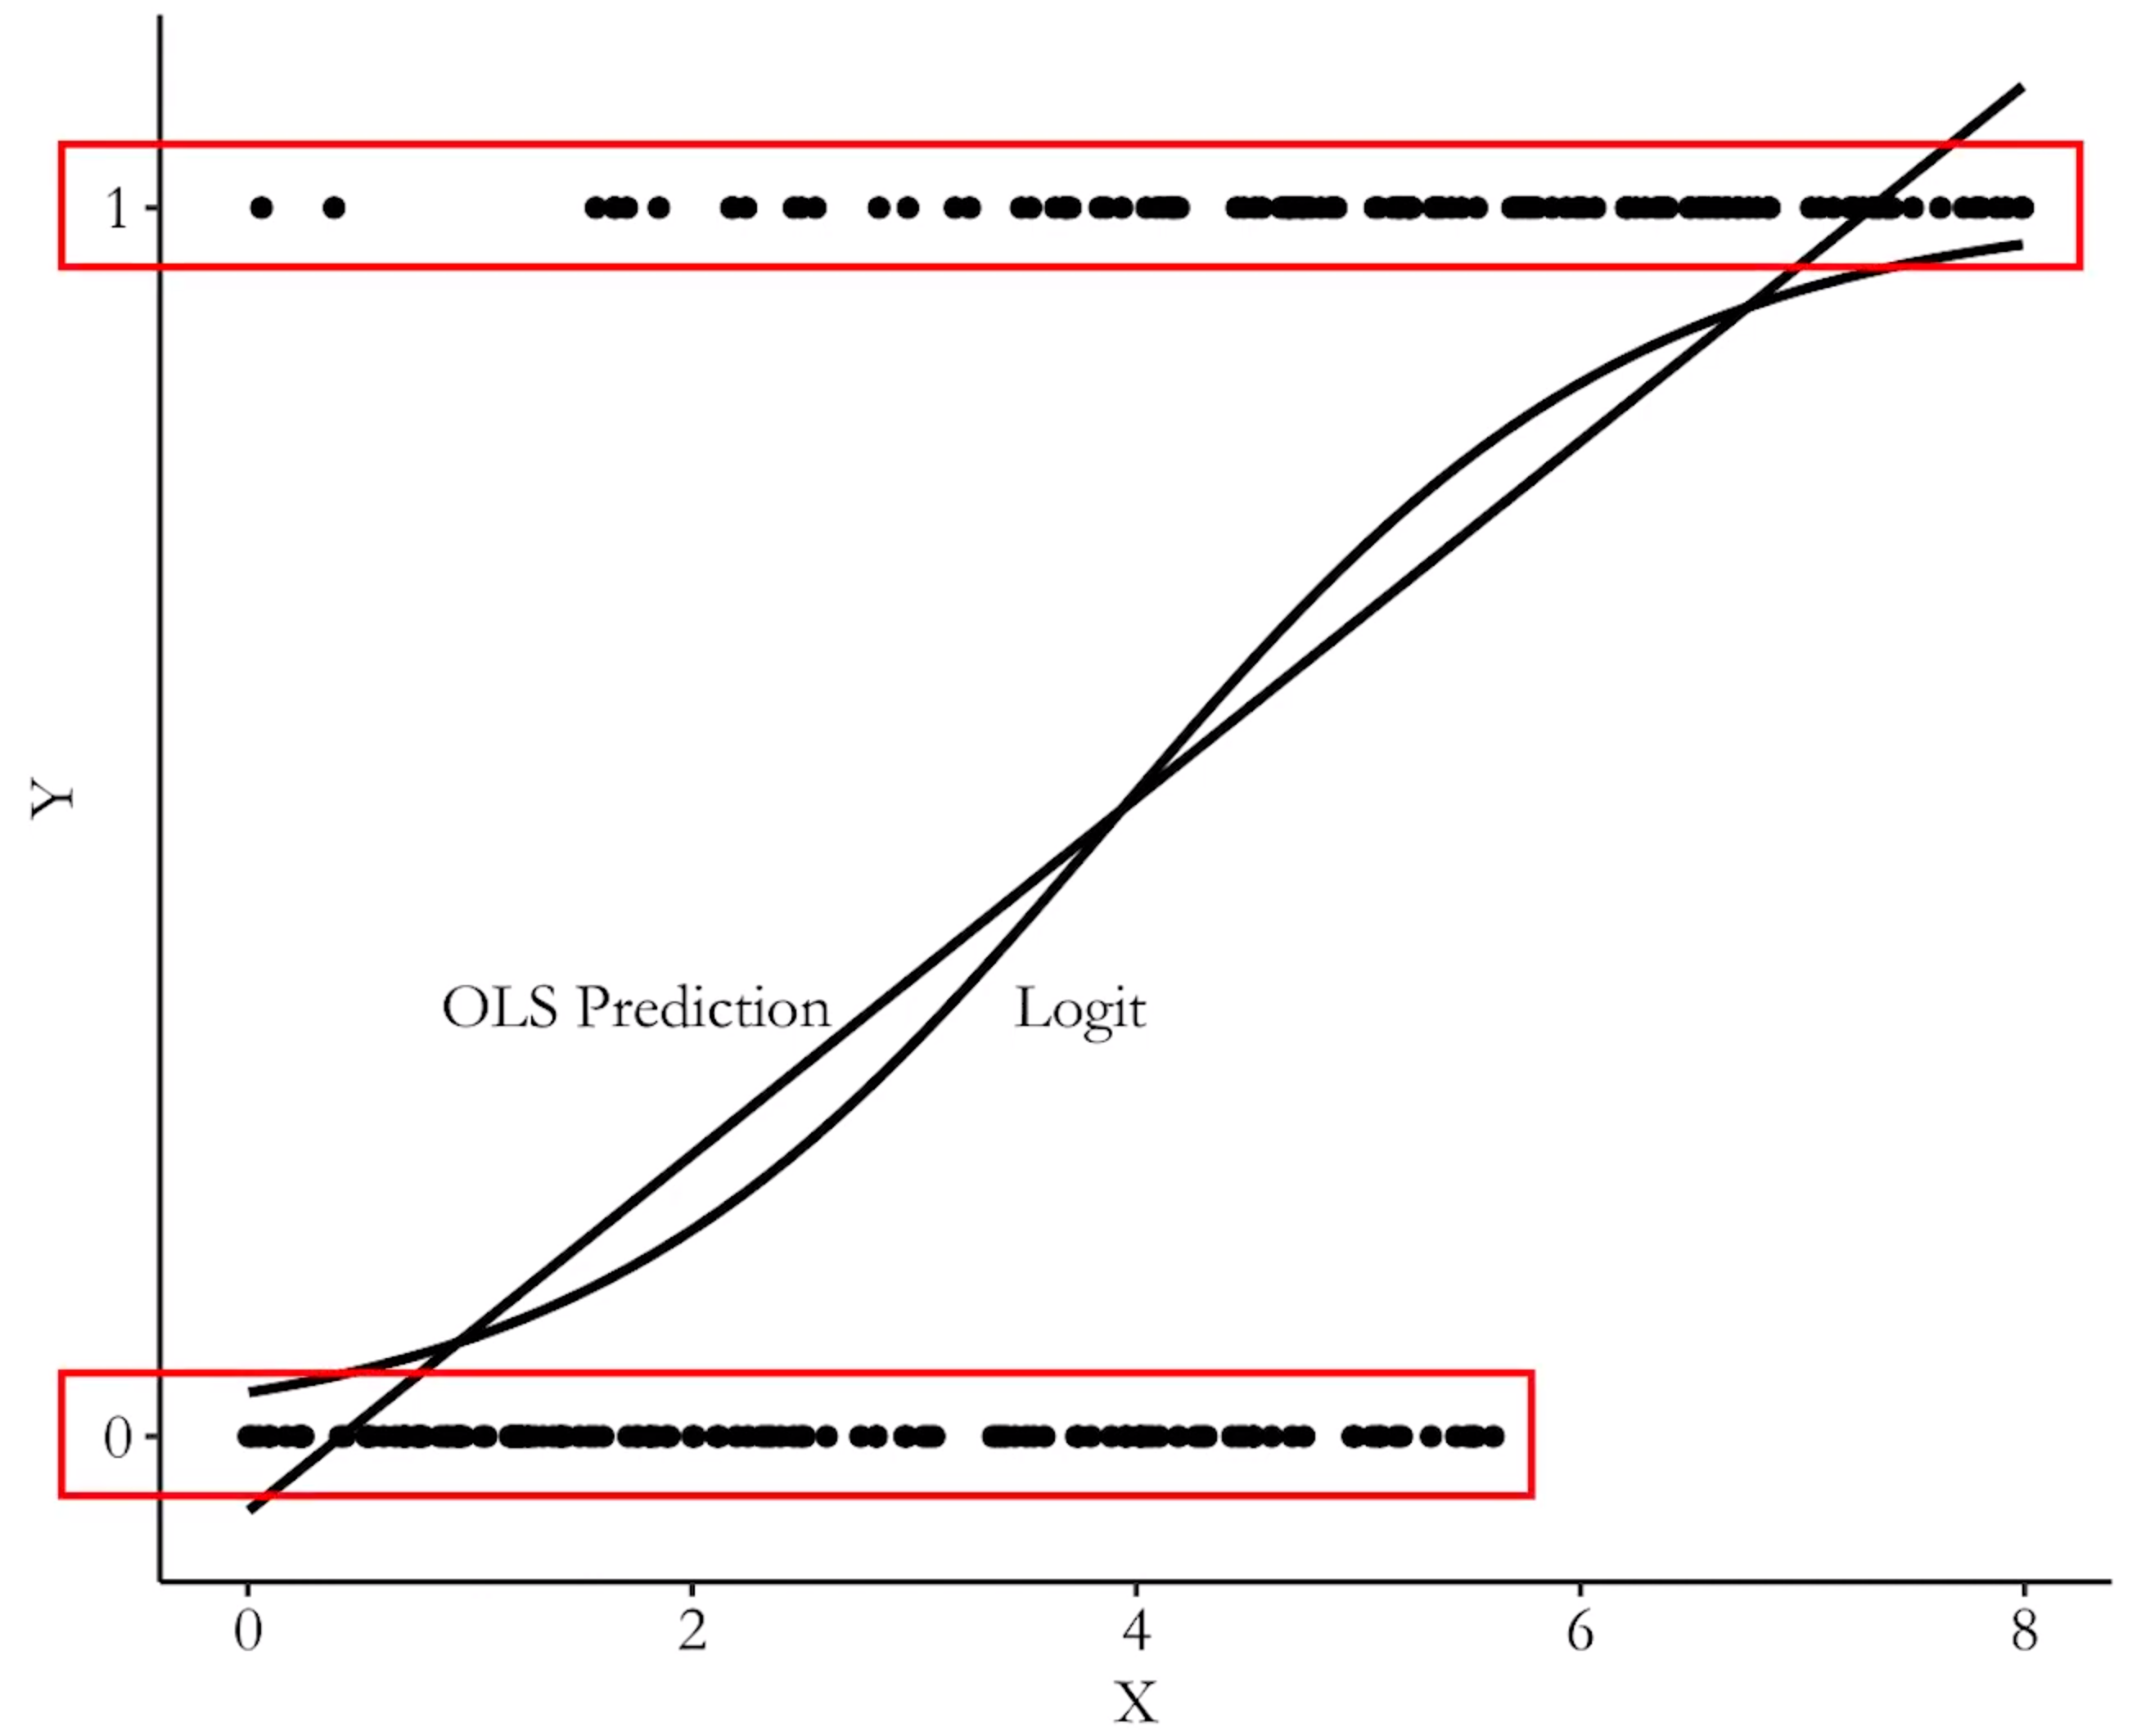
Plot X and Y, draw a line

Slide 8
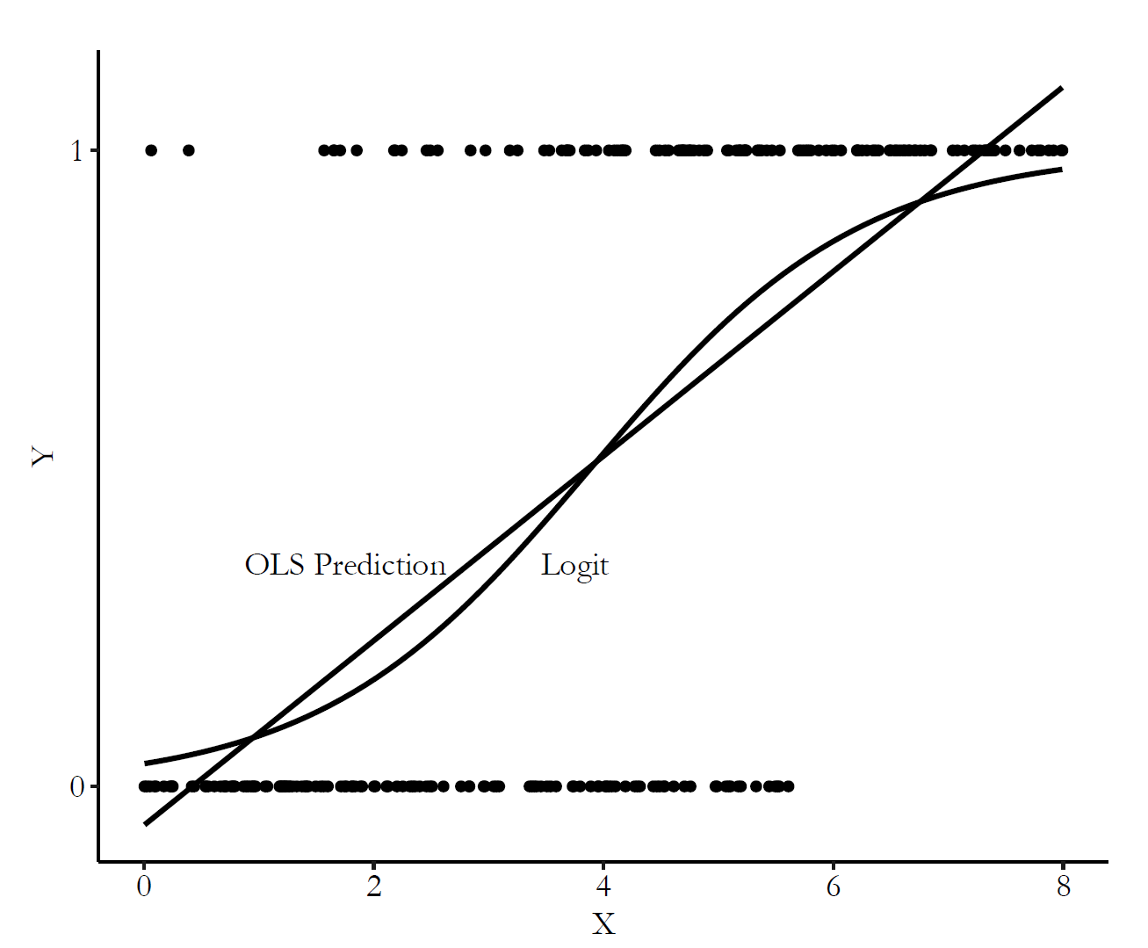
Plot X and Y, draw a line

Slide 9
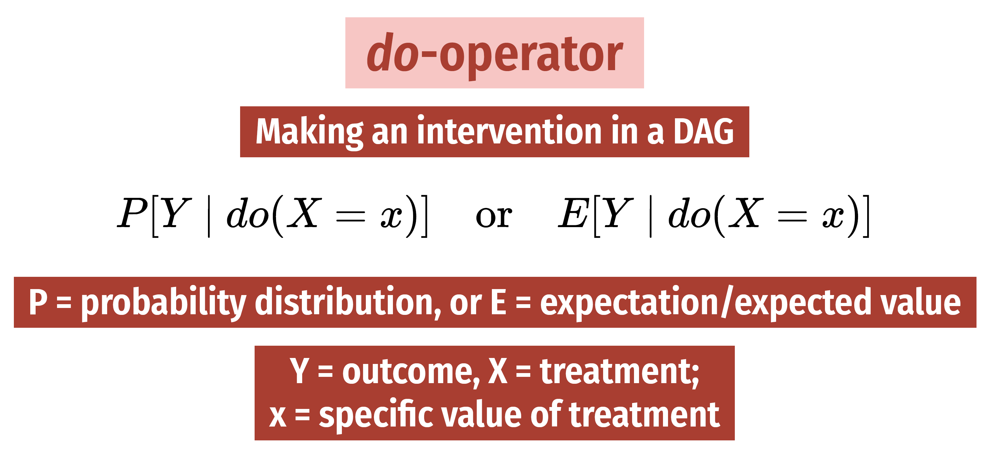
Remember (2)?
We’re now modeling conditional probabilities

Slide 10
Linear probability models (LPMs)
You now know OLS, how to find the “mathy parts” of that straight line, and how to interpret the math

Slide 11
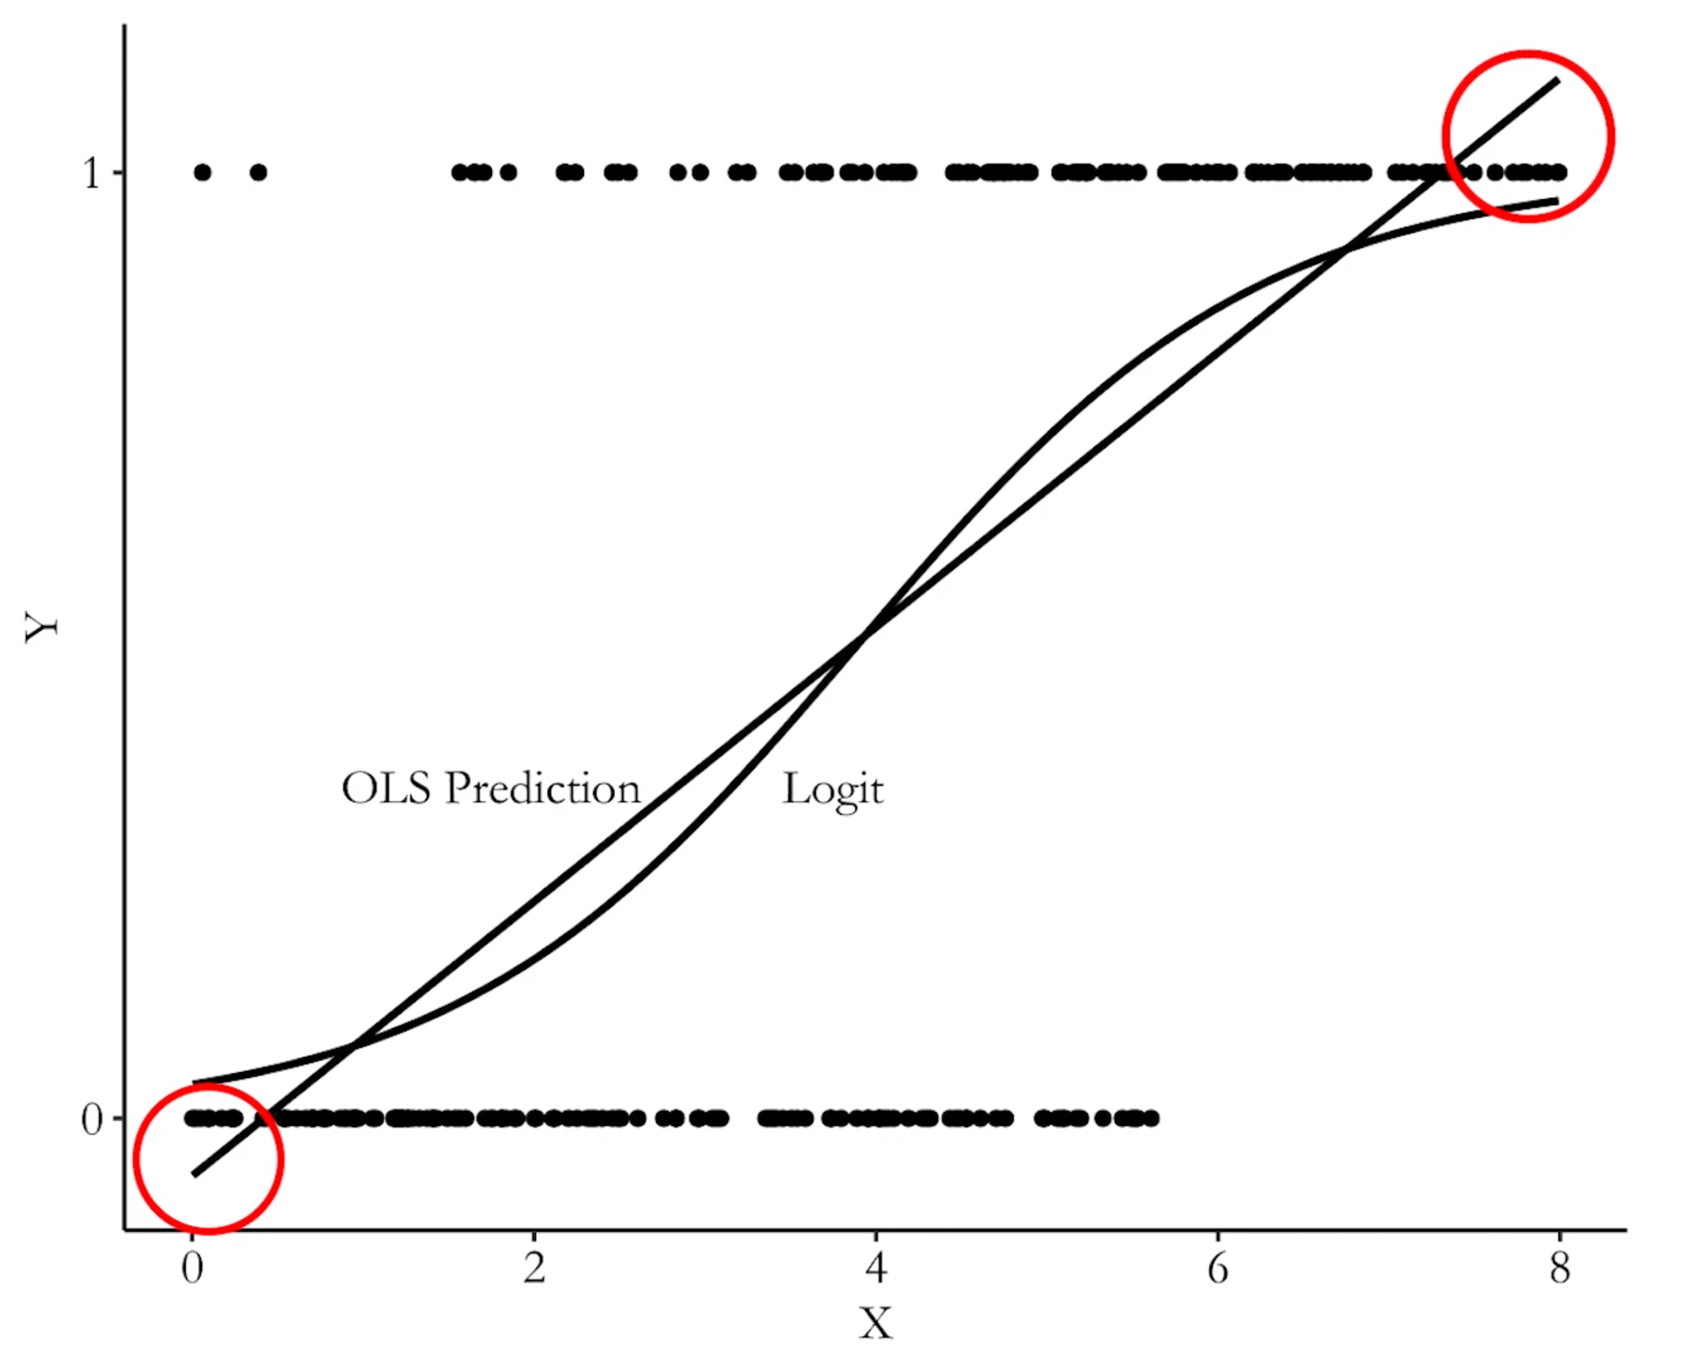
OLS / LPMs are great, but can be limited
Produce probabilities outside [0,1]
Assume a linear relationship in the tails

Slide 12
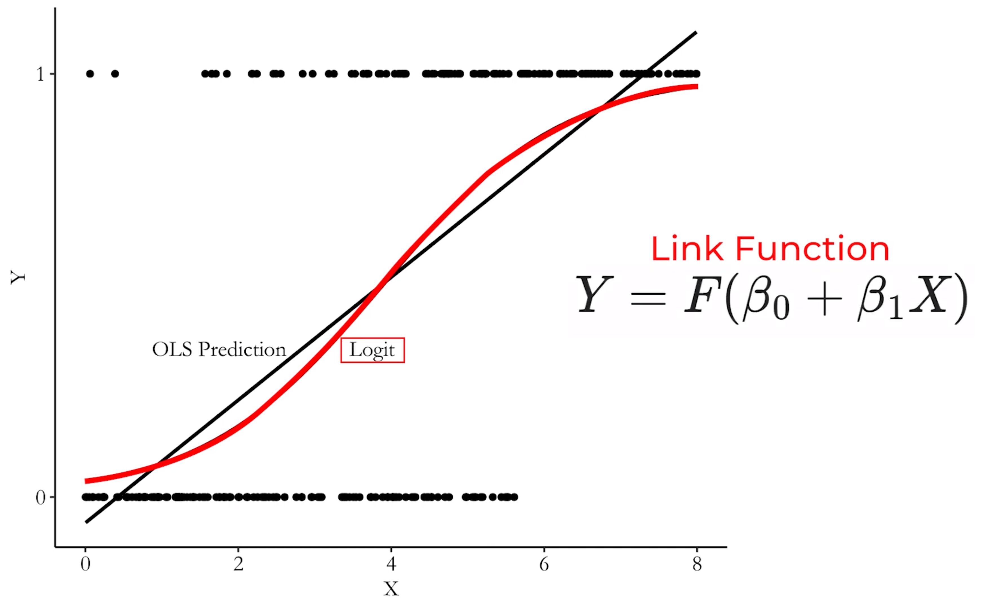
Non-linear regression to the rescue

Slide 13
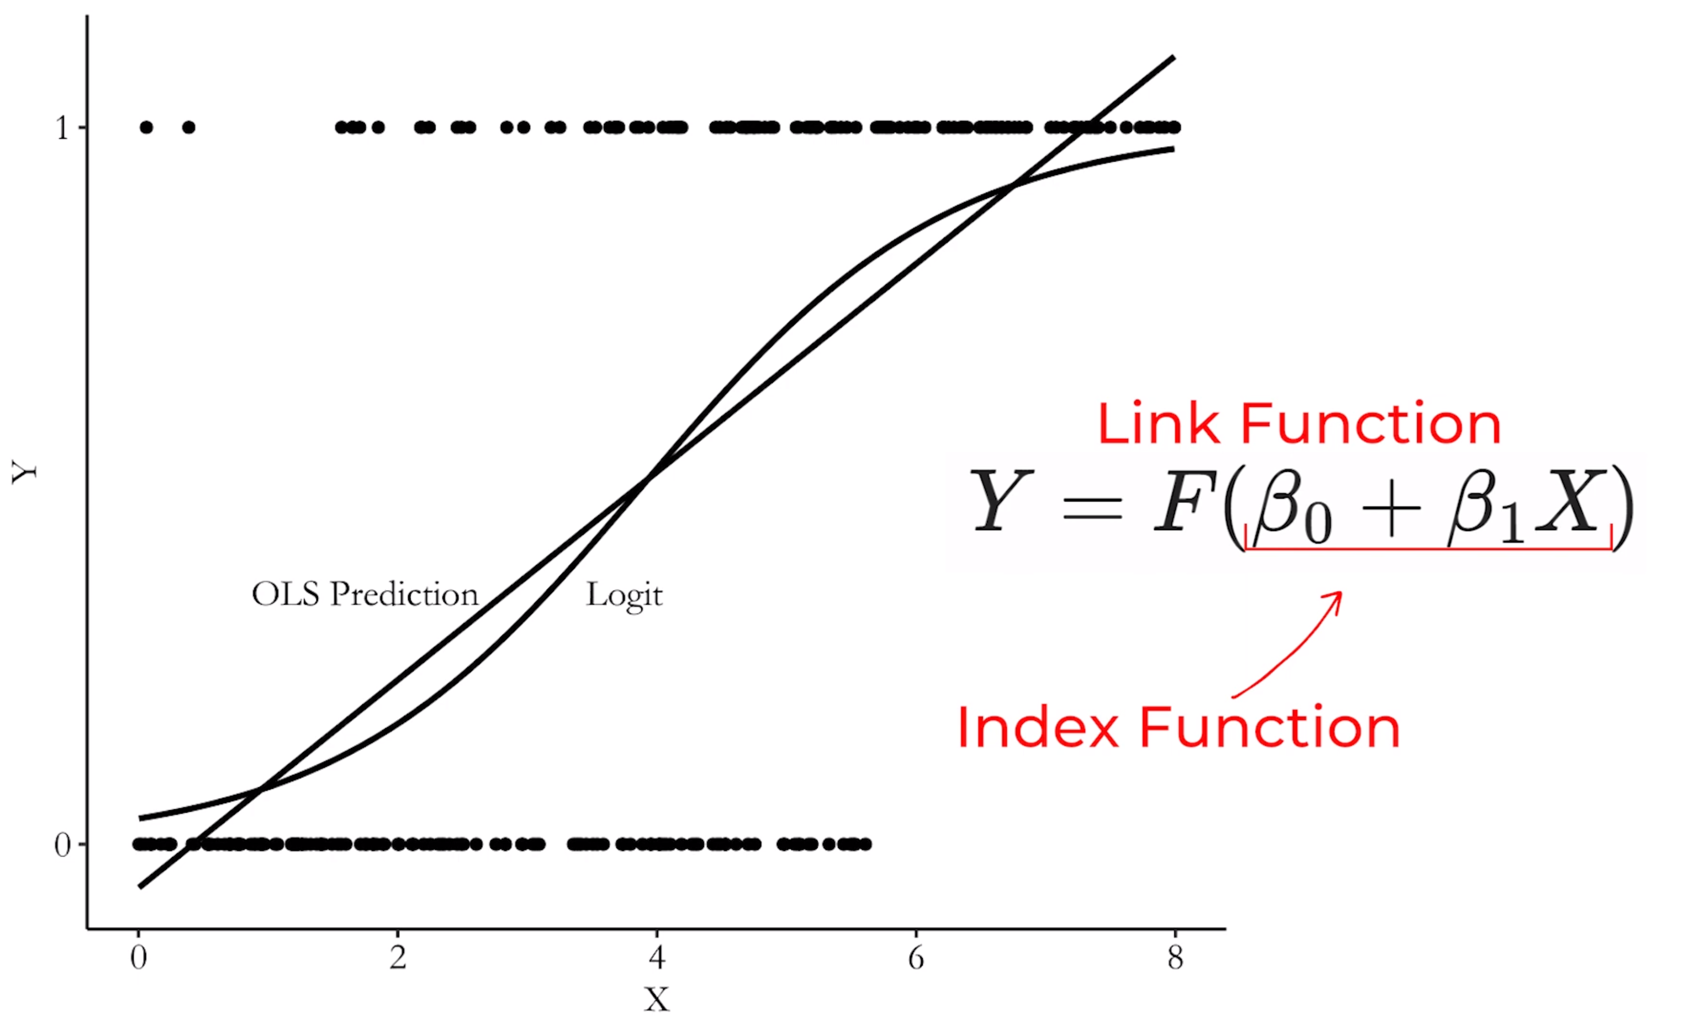
All flavors of generalized linear models

Slide 14
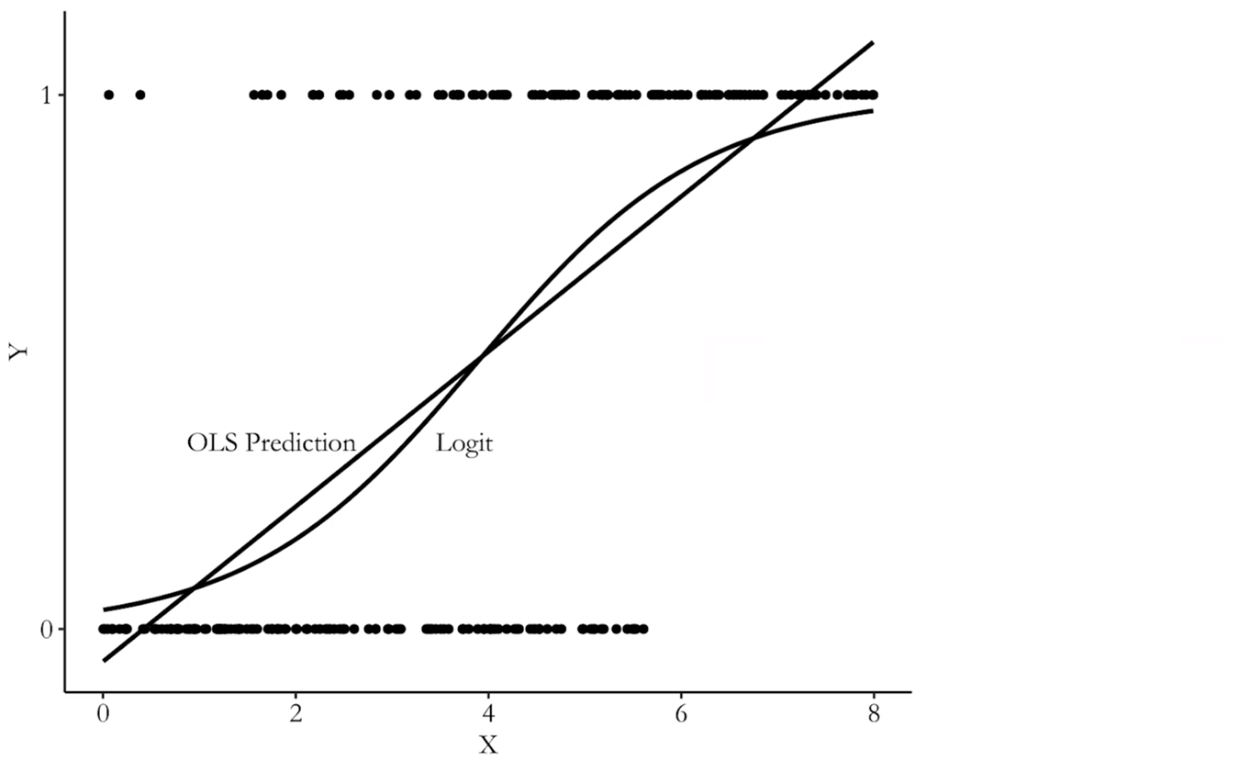
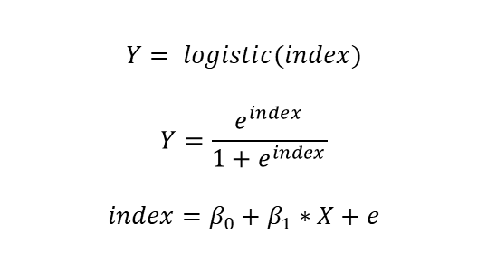
The logit link function
$$Y= logistic(index)$$
$$Y=\frac{e^{index}}{1+e^{index}}$$
$$index=β_{0}+β_{1}∗X+e$$

Slide 15
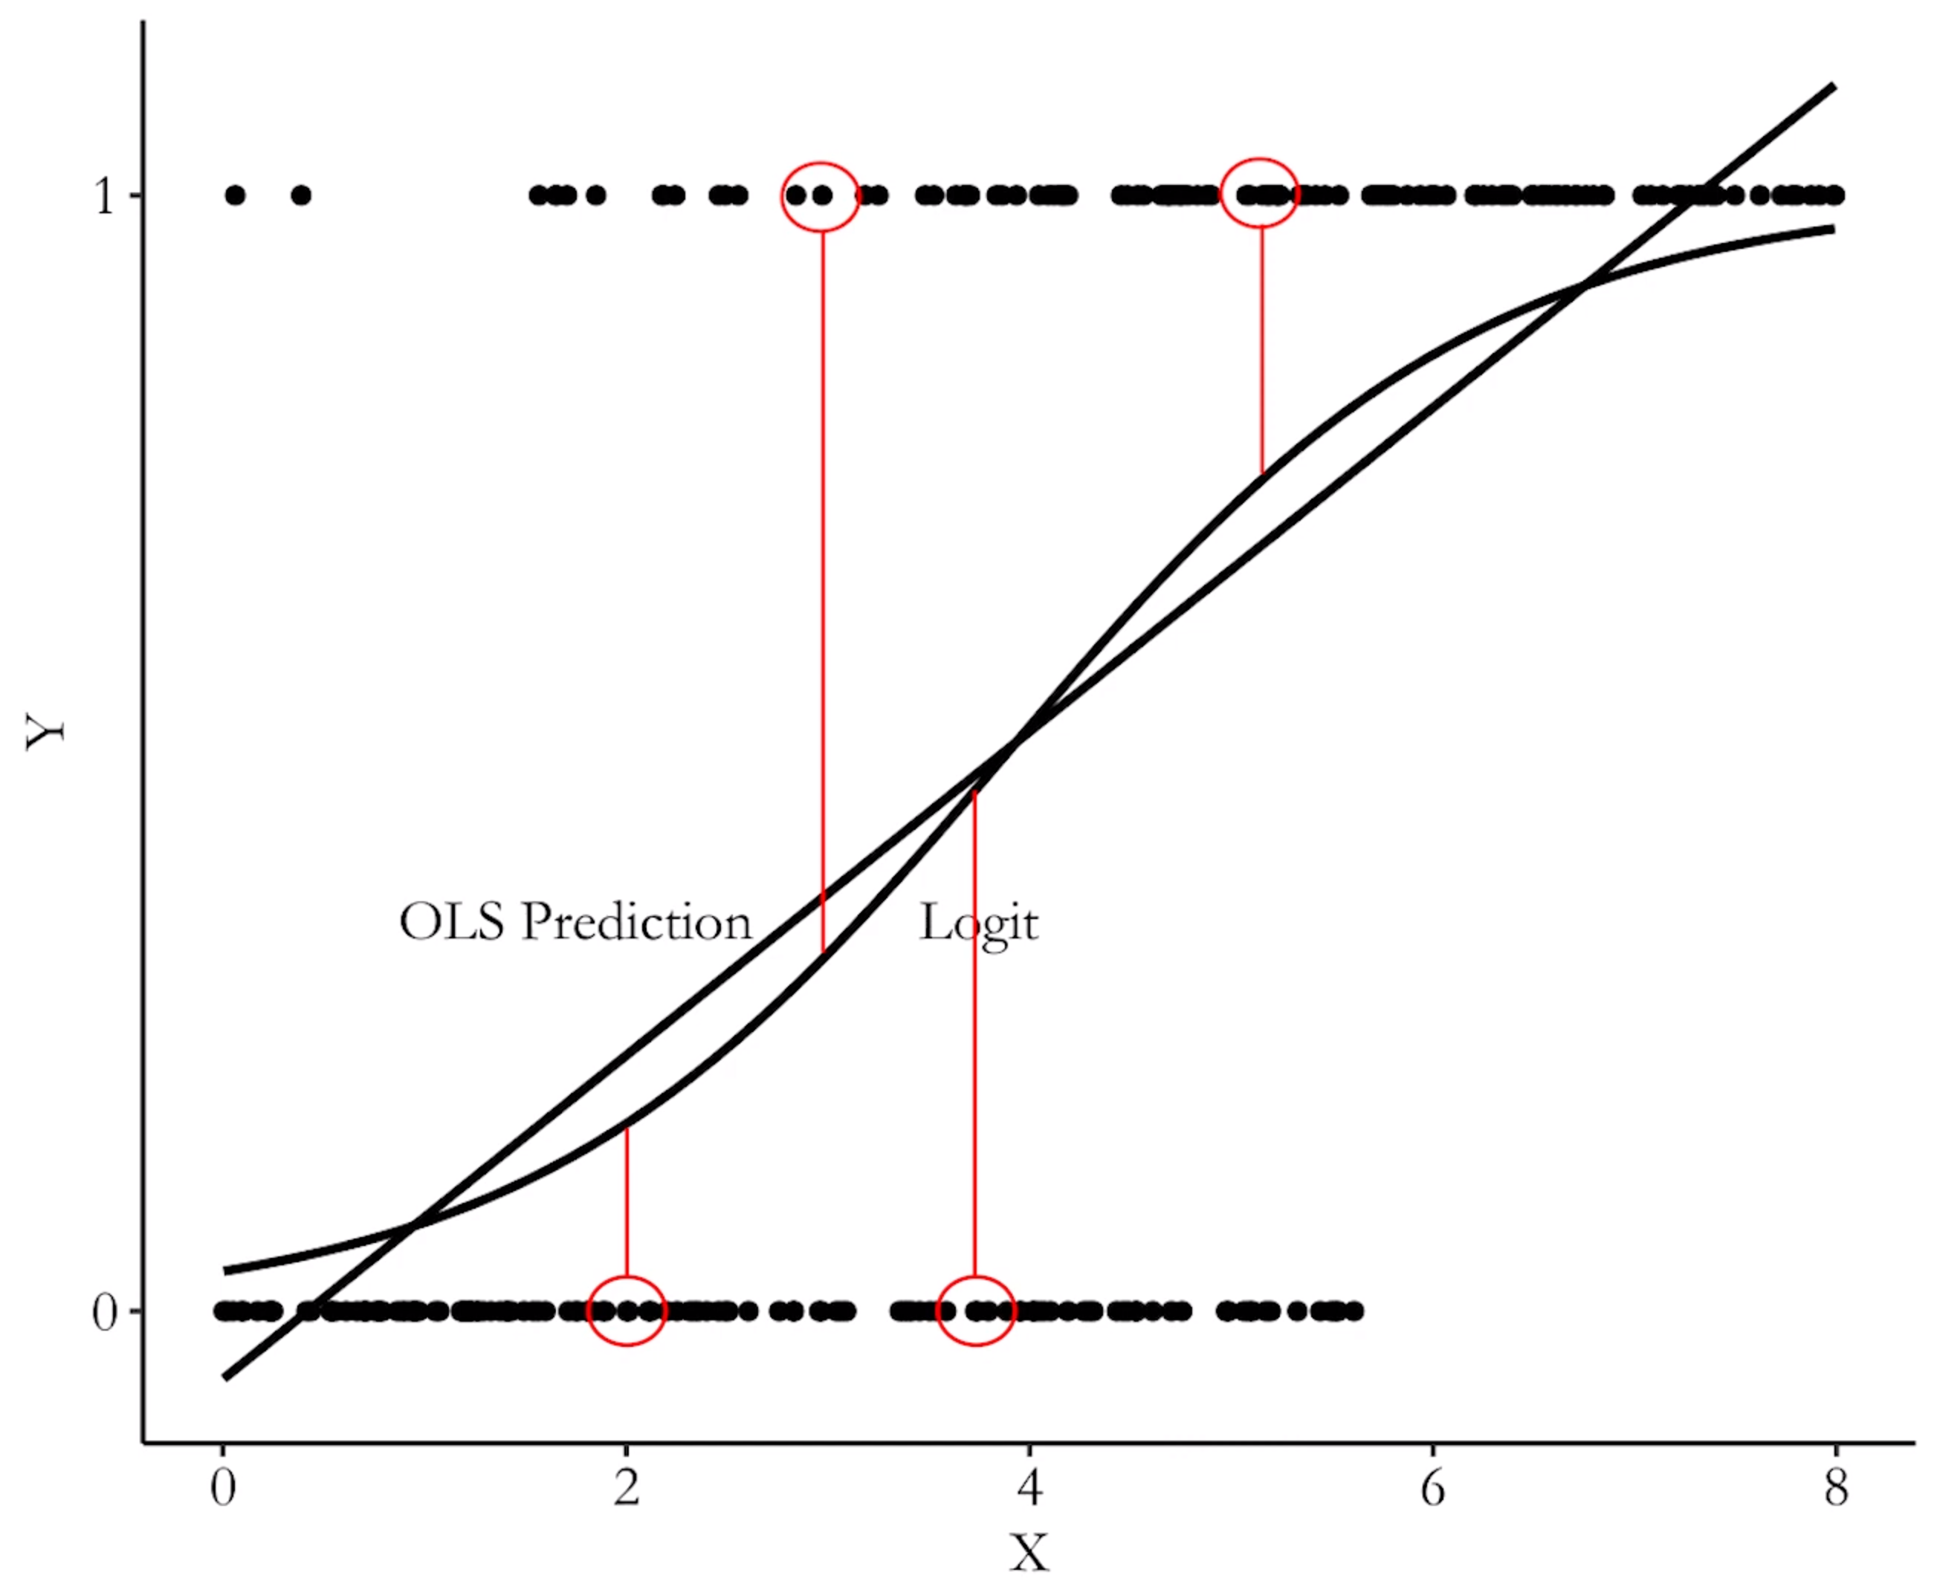
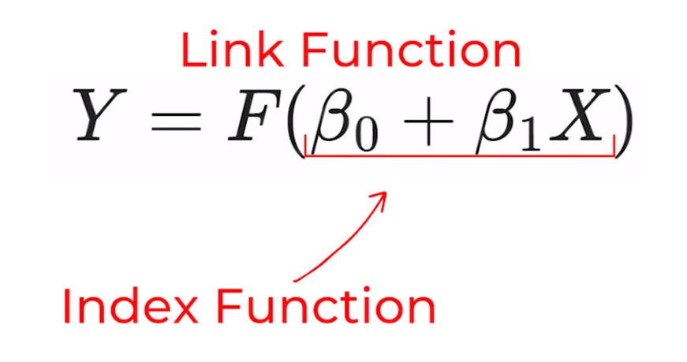
Coefficients still min. the sum of residuals²

Slide 16
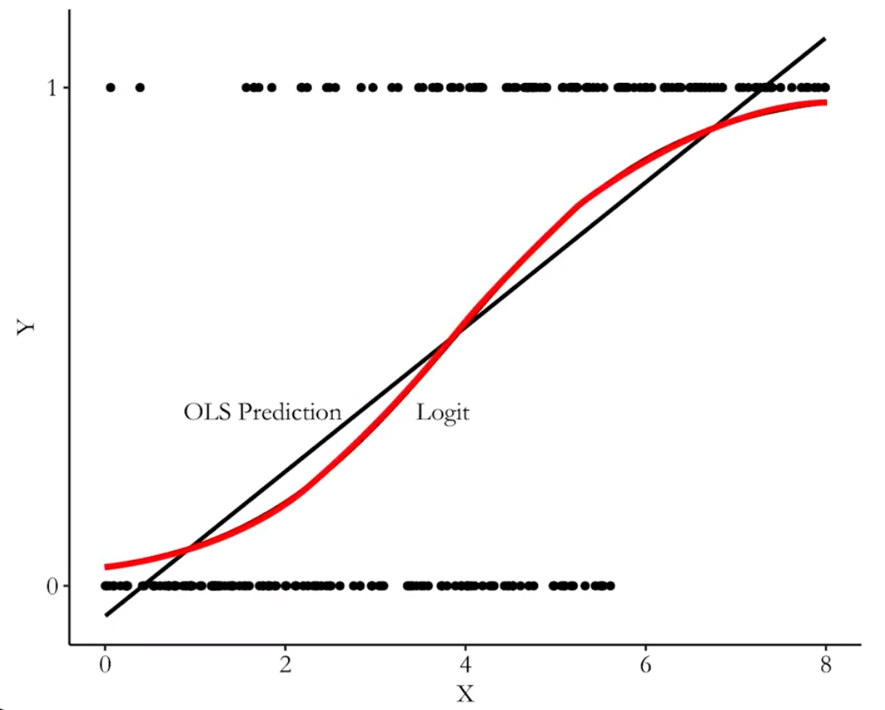

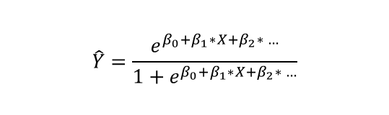
Congrats, you just predicted probabilities
Bivariate (one predictor)
$$\hat{Y}=\frac{e^{β_{0}+β_{1}∗X}}{1+e^{β_{0}+β_{1}∗X}}$$
Multivariate (more than one predictor)
$$\hat{Y}=\frac{e^{β_{0}+β_{1}∗X+β_{2}∗ …}}{1+e^{β_{0}+β_{1}∗X+β_{2}∗ …}}$$

Slide 17
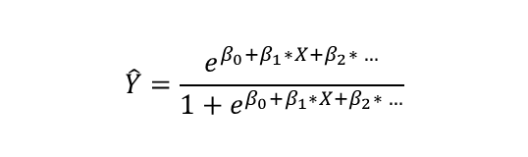

Interpret the math
How do we interpret “the effect of a one-unit increase in X on Y”? What’s the “marginal effect”?
Bivariate (one predictor)
$$\hat{Y}=\frac{e^{β_{0}+β_{1}∗X}}{1+e^{β_{0}+β_{1}∗X}}$$
Multivariate (more than one predictor)
$$\hat{Y}=\frac{e^{β_{0}+β_{1}∗X+β_{2}∗ …}}{1+e^{β_{0}+β_{1}∗X+β_{2}∗ …}}$$

Slide 18
Interpret the math
Option 1: Marginal effect at the mean. Contrast fitted values for X values “of interest”, and setting all controls to their means
“Holding all other variables constant at their means, assignment to treatment led to a [marg. effect at the mean] percentage-point increase in the probability of Y”. X values of interest: Treatment vs control (1/0). “Holding all other variables constant at their means, if X is increased to a level that is 1 [x-unit] above the mean of X, this leads to a [marg. effect at the mean] percentage-point increase in the probability of Y”. X values of interest: Mean of X vs 1 x-unit above the mean of X.

Slide 19
Interpret the math
Option 2: Average marginal effect. Contrast fitted values for X values “of interest”, keep all controls at their observed values; then, average across all the predicted effects
“Keeping all other variables as observed in the sample, assignment to treatment led to a [avg. marg. effect] percentage-point increase in the probability of Y”. X values of interest: Treatment or control “Keeping all other variables as observed in the sample, if each person’s X was ten points higher, this will lead to a [avg. marg. effect] percentage-point increase in the probability of Y”. X values of interest: X as observed vs 1 x-unit higher than the observed X.

Slide 20
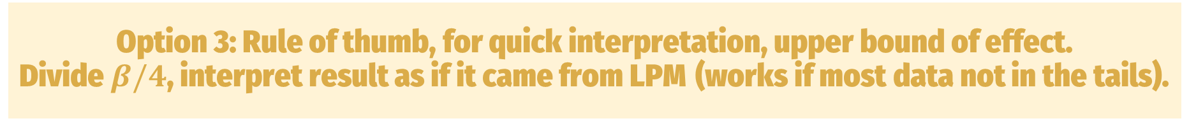
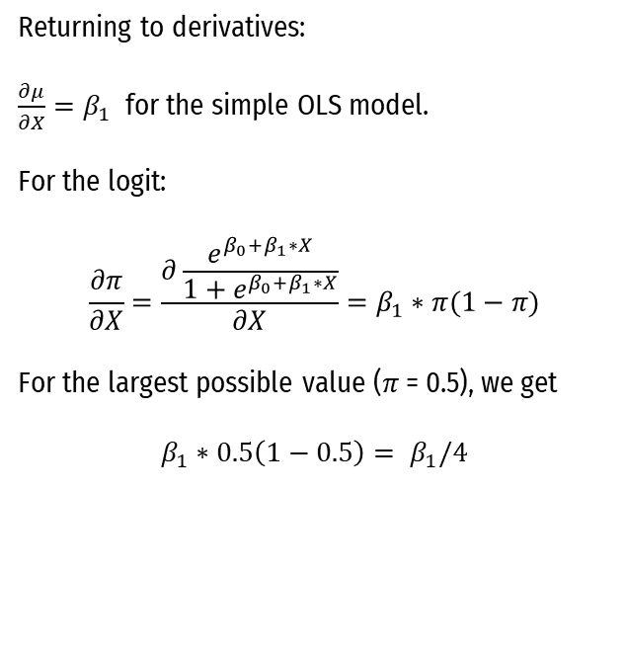
Interpret the math
Option 3: Rule of thumb, for quick interpretation, upper bound of effect. Divide $β/4$, interpret result as if it came from LPM (works if most data not in the tails).
Returning to derivatives:
$\frac{∂μ}{∂X}=β_{1}$ for the simple OLS model.
For the logit:
$$\frac{∂π}{∂X}=\frac{∂\frac{e^{β_{0}+β_{1}∗X}}{1+e^{β_{0}+β_{1}∗X}}}{∂X}=β_{1}∗π(1−π)$$
For the largest possible value ($π$ = 0.5), we get
$$β_{1}∗0.5\left(1−0.5\right)= β_{1}/4$$

Slide 21
Bounding

Slide 22
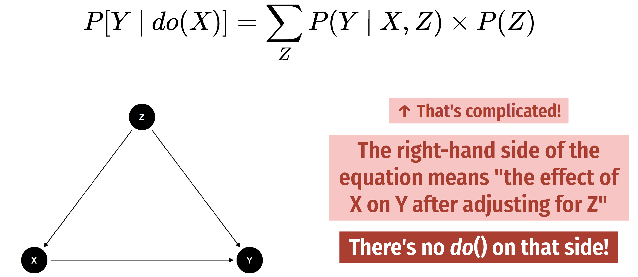
How bad can the omitted variable bias be?

Slide 23
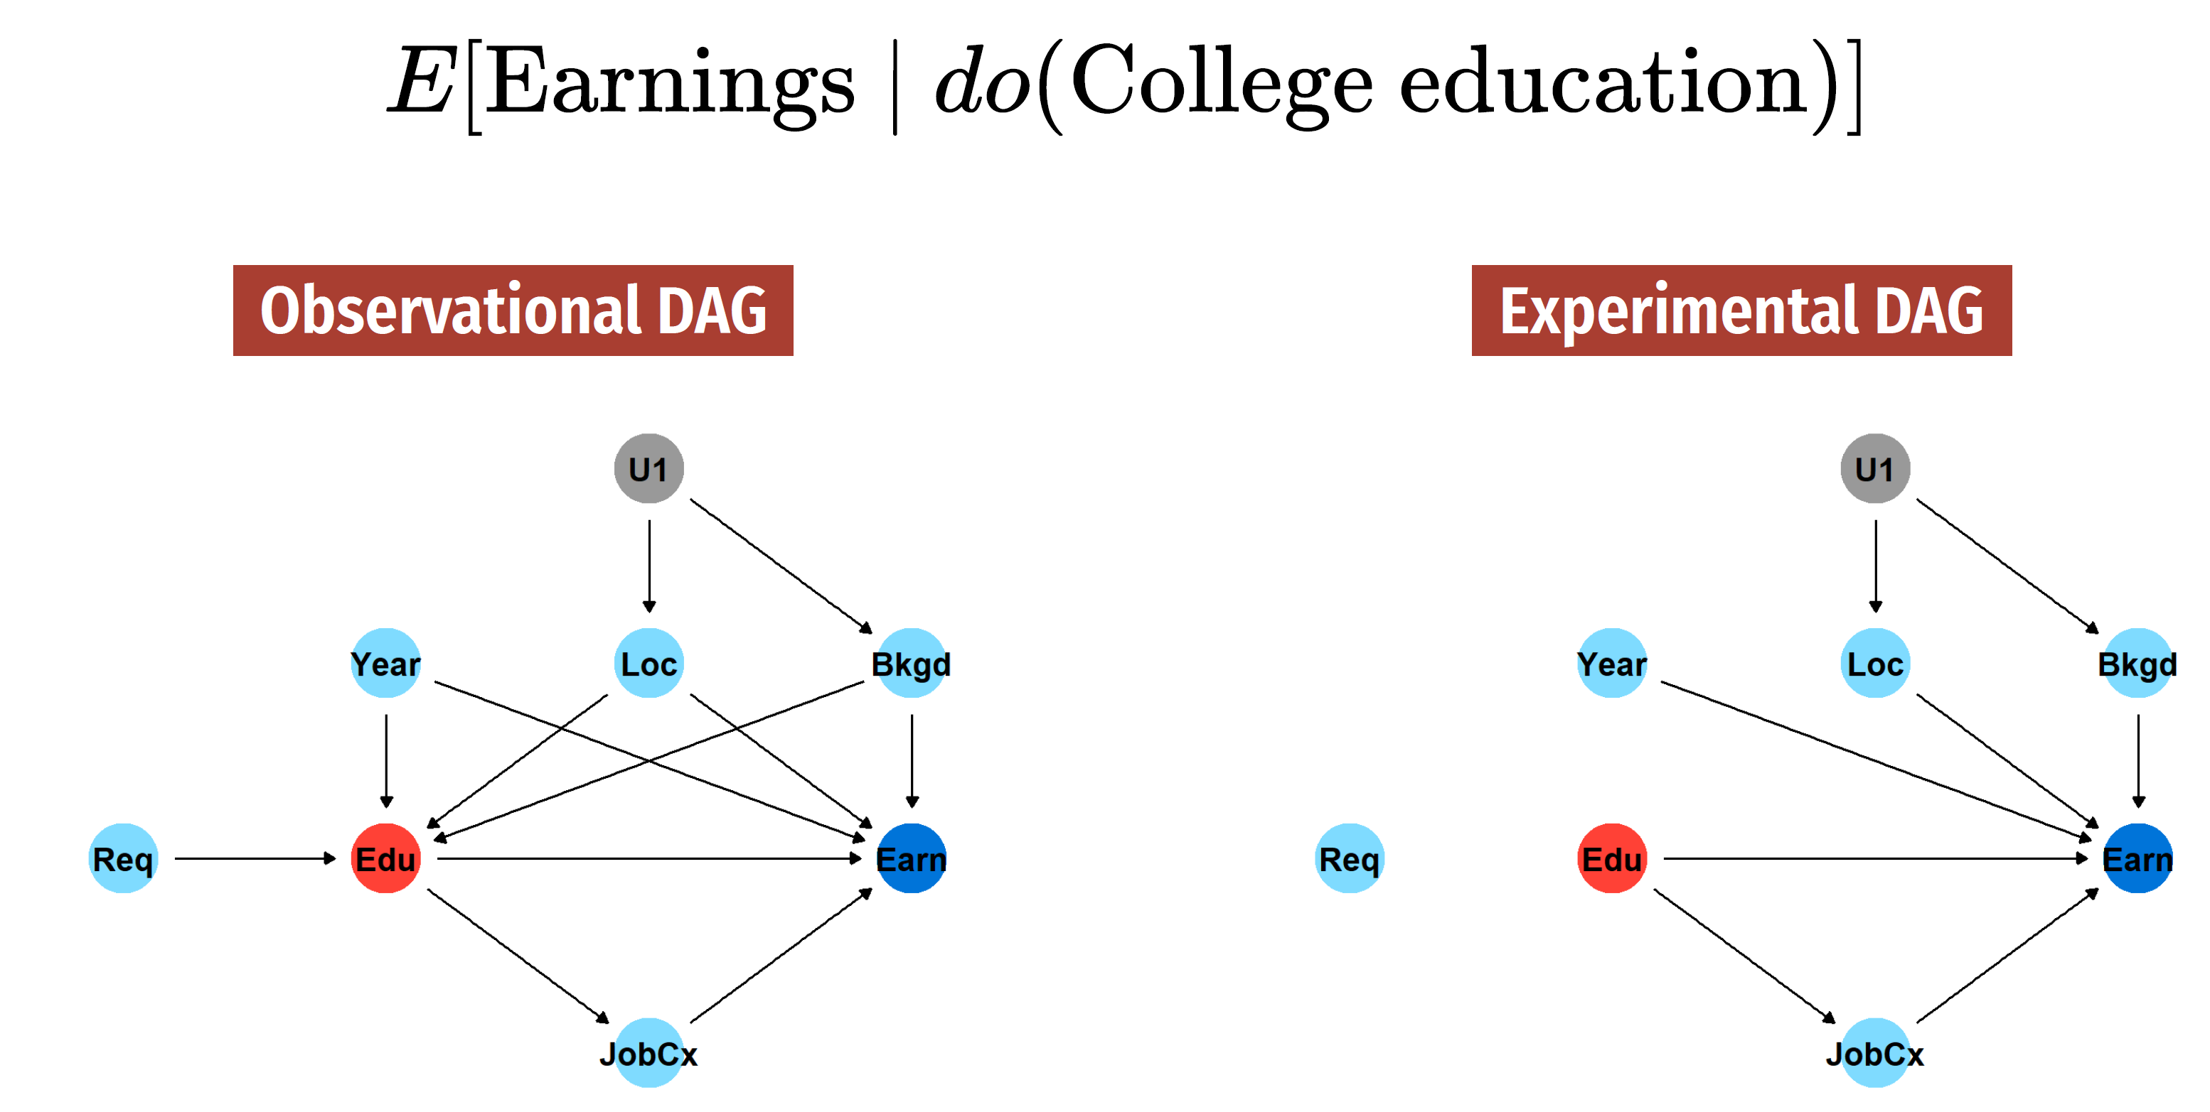
What if I can’t close all relevant backdoors?

Slide 24
With Oster (2019), we can answer 2 questions
Relative to the observed confounders, how important would the unobserved confounders have to be for my observed effect to be actually zero?
Under assumptions about how important the unobserved confounders are relative to the observed confounders, what is a reasonable bias-adjusted treatment effect?

Slide 25
Intuition – Part 1
I can observe my coefficient of main interest move as I’m closing those backdoors I do have data for.
Let’s assume the bias that is due to the remaining, unclosed backdoors goes in the same direction as the bias we just took care of. “If I had data on the unobservables and controlled for them, the X coefficient would move in the same direction.”

Slide 26
Intuition – Part 2
With more variance left—a low R-squared—there is more room for the unobserved variables to “do damage”.
Not all of the remaining, unexplained variance must relate to confounders.
“Omitted variable bias is proportional to coefficient movements, but only if movements are scaled by the change in R-squared when controls are included”

Slide 27
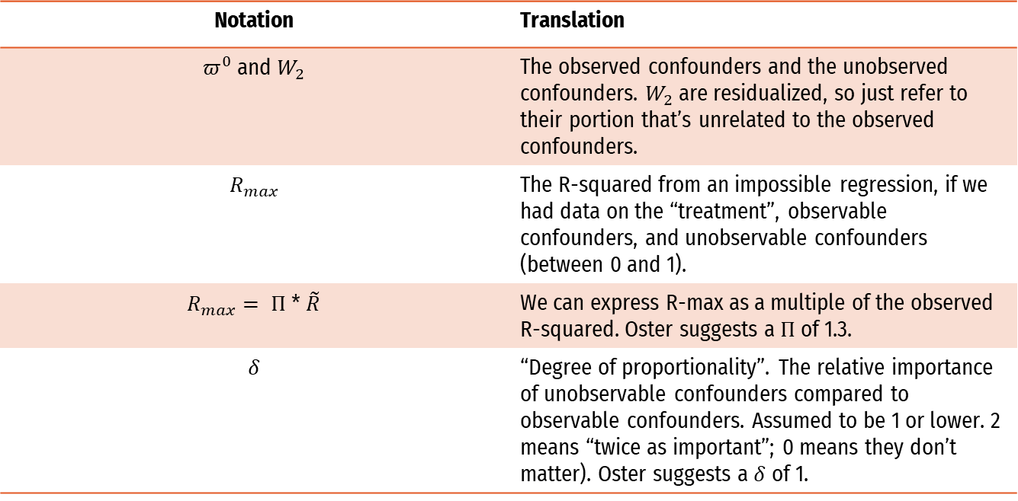
Words > symbols (words are better)
Notation | Translation
$π^{0}$ and $W_{2}$ | The observed confounders and the unobserved confounders. $W_{2}$ are residualized, so just refer to their portion that’s unrelated to the observed confounders.
$$R_{max}$$ | The R-squared from an impossible regression, if we had data on the “treatment”, observable confounders, and unobservable confounders (between 0 and 1).
$R_{max}= Π$ * $\tilde{R}$ | We can express R-max as a multiple of the observed R-squared. Oster suggests a $Π$ of 1.3.
$$δ$$ | “Degree of proportionality”. The relative importance of unobservable confounders compared to observable confounders. Assumed to be 1 or lower. 2 means “twice as important”; 0 means they don’t matter). Oster suggests a $δ$ of 1.

Slide 28
Your independent research paper
Relative to the observed confounders, how important would the unobserved confounders have to be for my observed effect to be actually zero?
Under assumptions about how important the unobserved confounders are relative to the observed confounders, what is a reasonable bias-adjusted treatment effect?

Slide 29
Announcements
Milestone 1
Due on Sunday
DAM 1
Due on Tuesday
Exam on Feb 15
Rough study guide posted on the course website

